Slide 1
Road to the Code
A Phonological Awareness Program
Blachman Ph.D, Ball Ph. D, Black M.S., Tangel Ph.D
presented by: Ursula Conway
uconway@pausd.org

Slide 2
What is Phonological awareness?
[...] Phonological awareness is an awareness of the phonological segments in speech - the segments of speech that are more or less represented by the letters of the alphabet [phonemes]. Research has shown that without this awareness, it is difficult to understand how an alphabet works.(Blachman, Ball, Black & Tangel)

Slide 3
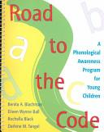
Program Overview
One manual
40 lessons, 15-20 minutes each
approximately 10 weeks, 4x per week.
designed for Kinder to 1st grade
Appropriate for students with
phonological deficits K-3
8 letters + vowels

Slide 4
Activities
Say it and Move it
Elkonin Cards
Puppet Blending
How Many Sounds? Finger segmenting
Mailbox
Onset/Rime activity
Go Fish
Letter Cards
Save the Rabbit

Slide 5
Student Profile
demonstrates poor left-to-right directionality
limited letters or errors in letter sound production
“schwa” added to consonants
ineffective blending/segmenting - appears to lack efficient strategies
“Delay” apparent in blending, tracking or letter/sound relationship
Limited response to reading intervention
Students may be English Language Learners, have auditory processing issues or be receiving speech services.

Slide 6
Key Concepts
letter sounds/phonemes have specific qualities and are represented with manipulatives
precise
voiceless consonants
“Long” sounds and “Hot” Sounds ie: continuous and
finite letter sounds
Left to Right Directionality
1-1 correspondence
Reducing “delay” and accurate finger tracking
Segmenting and blending

Slide 7
Goals for this session...
Develop a deeper understanding of phonological awareness
Extend your understanding of letter sounds and phonemes - allowing you to teach them in a more tangible way
The ability to diagnose issues related to phonological awareness
Ability to teach some of the core activities

Slide 8
My experience with RTC
Official Kinder intervention program
Implemented with students receiving IEP services 1st-3rd
Implemented in my 2nd-3rd SAI class with the majority of incoming students prior to guided reading instruction.
My first step with the majority of my incoming students - most of whom were not reading.
I found that students needed these foundation skills before they could gain full benefit from guided reading instruction.
Most students displayed an “imbalance” in reading behavior (visual, meaning, structure) and were over reliant on inefficient coping strategies.
All students showed progress after completing this program.
Developed a “hybrid” program

Slide 9
Today we will….
See an overview of modified Road to the Code program
Work in pairs or small groups to explore the core activities within the program
Practice diagnosing errors and providing corrective feedback
Experiment with lesson extensions and modifications
Discuss ways to integrate Zoophonics within RTC

Slide 10
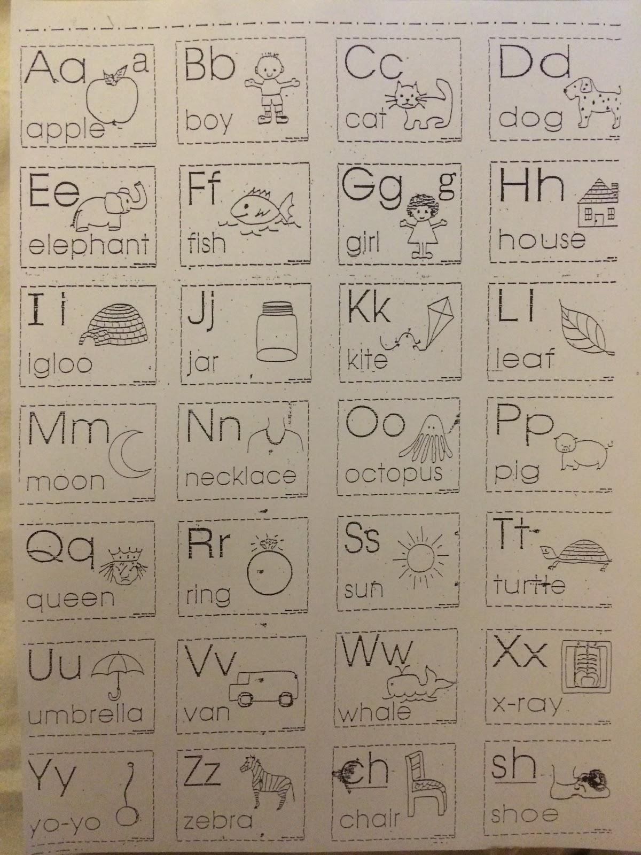
ACTIVITY 1
Letter sounds partner activity

Slide 11
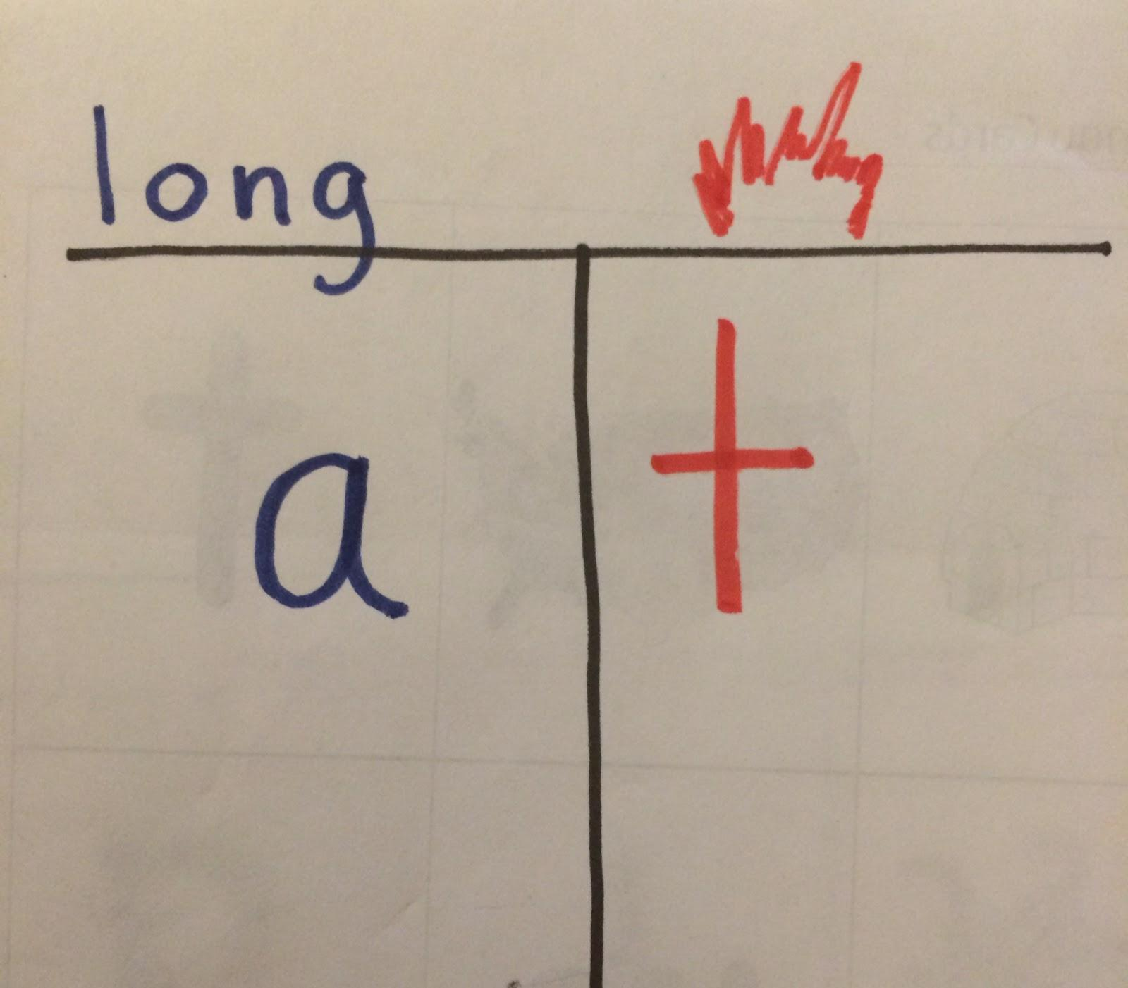
ACTIVITY 2
Long Sounds, Hot Sounds

Slide 12
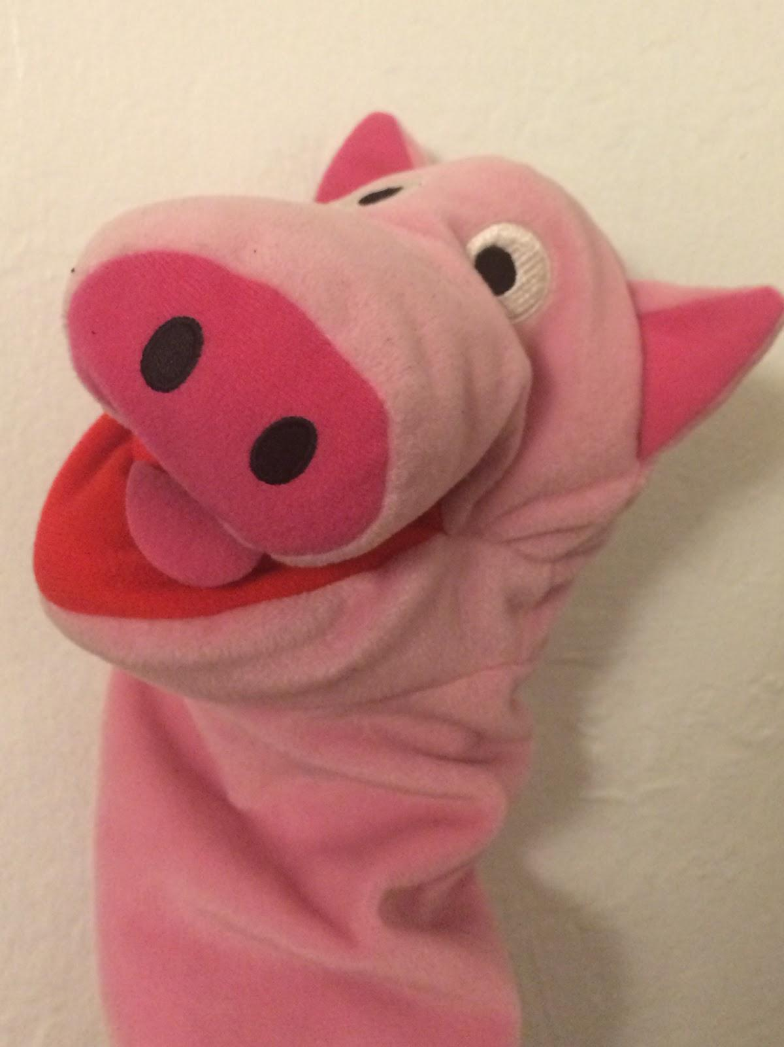
Supporting Activity Demo
How Many Sounds? finger segment
puppet blending
onset/rime
Mailbox
Bingo
Go fish
Save the Rabbit

Slide 13
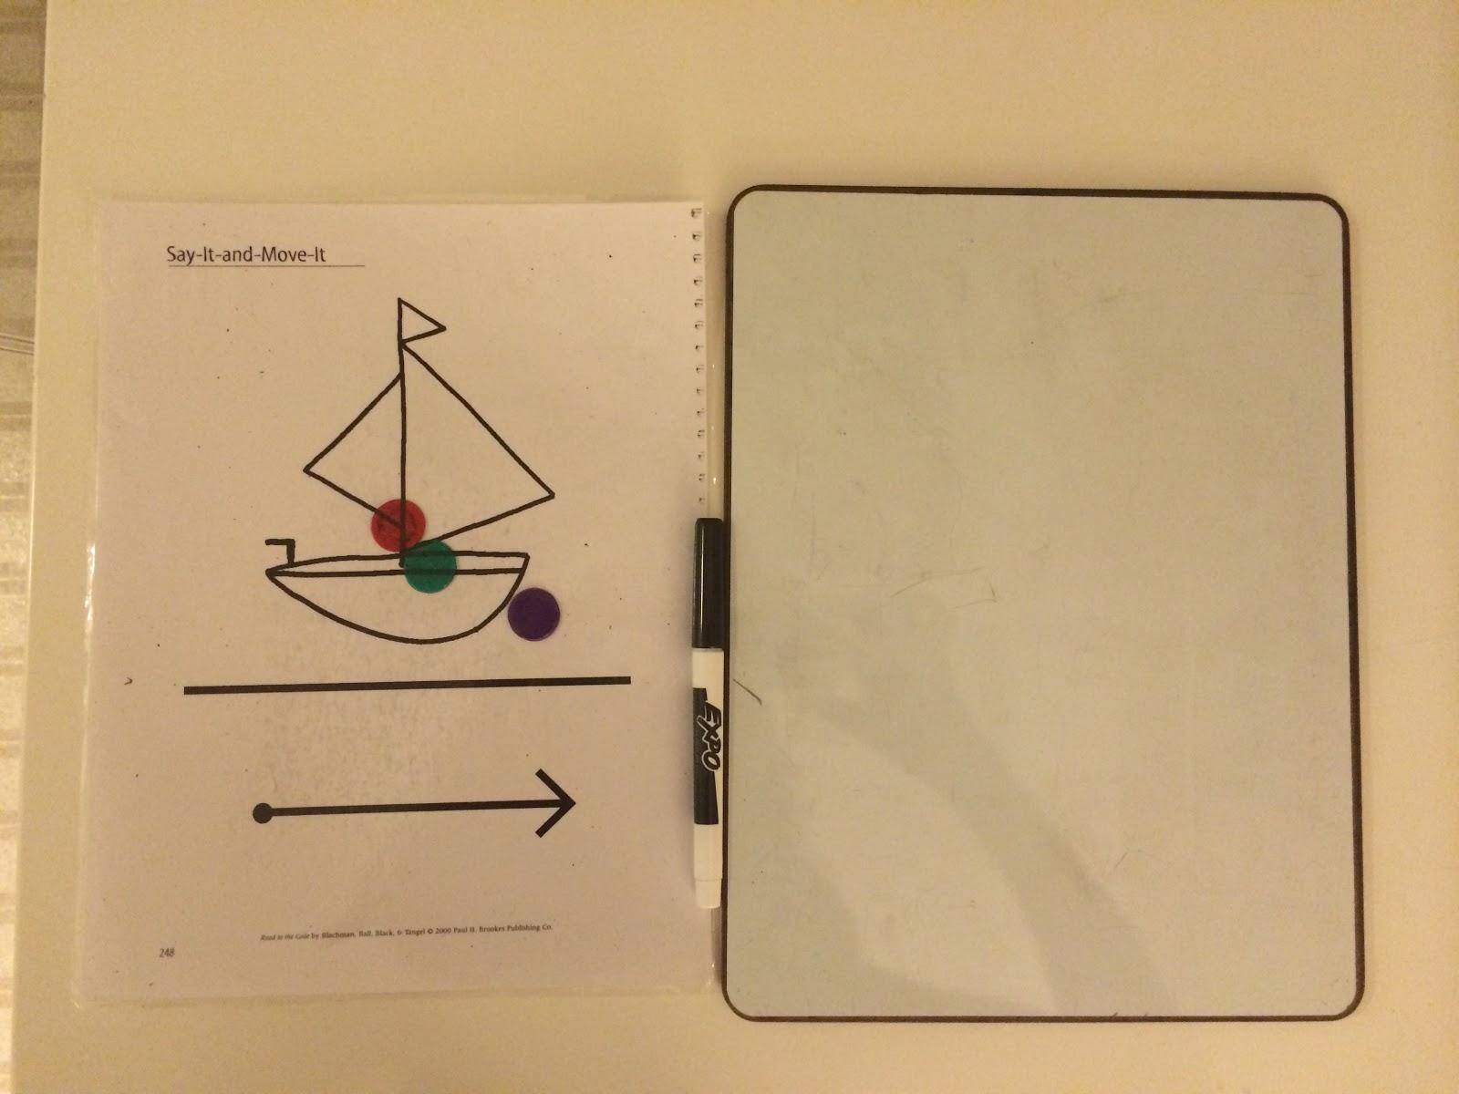
Activity 3
Say it and Move it

Slide 14
Typical Errors
incorrect letter sounds, schwa
poor 1-1
inability to isolate individual phonemes in words or segment
blending delay
tracking delay
incorrect eye, finger tracking

Slide 15
Integrating Zoophonics
Replace specific letter lessons in RTC with Zoophonics
Zoophonics letter mat
Zoophonics song to read words

Slide 16
Activity 4: Work in Pairs and Explore the Lessons
Setting up, managing materials & student expectations; teacher/student game ****VIDEO
Identify basic sounds
Identify letter sounds
two sounds
three sounds
three sounds, identify letter placement

Slide 17
Full Lesson Model

Slide 18
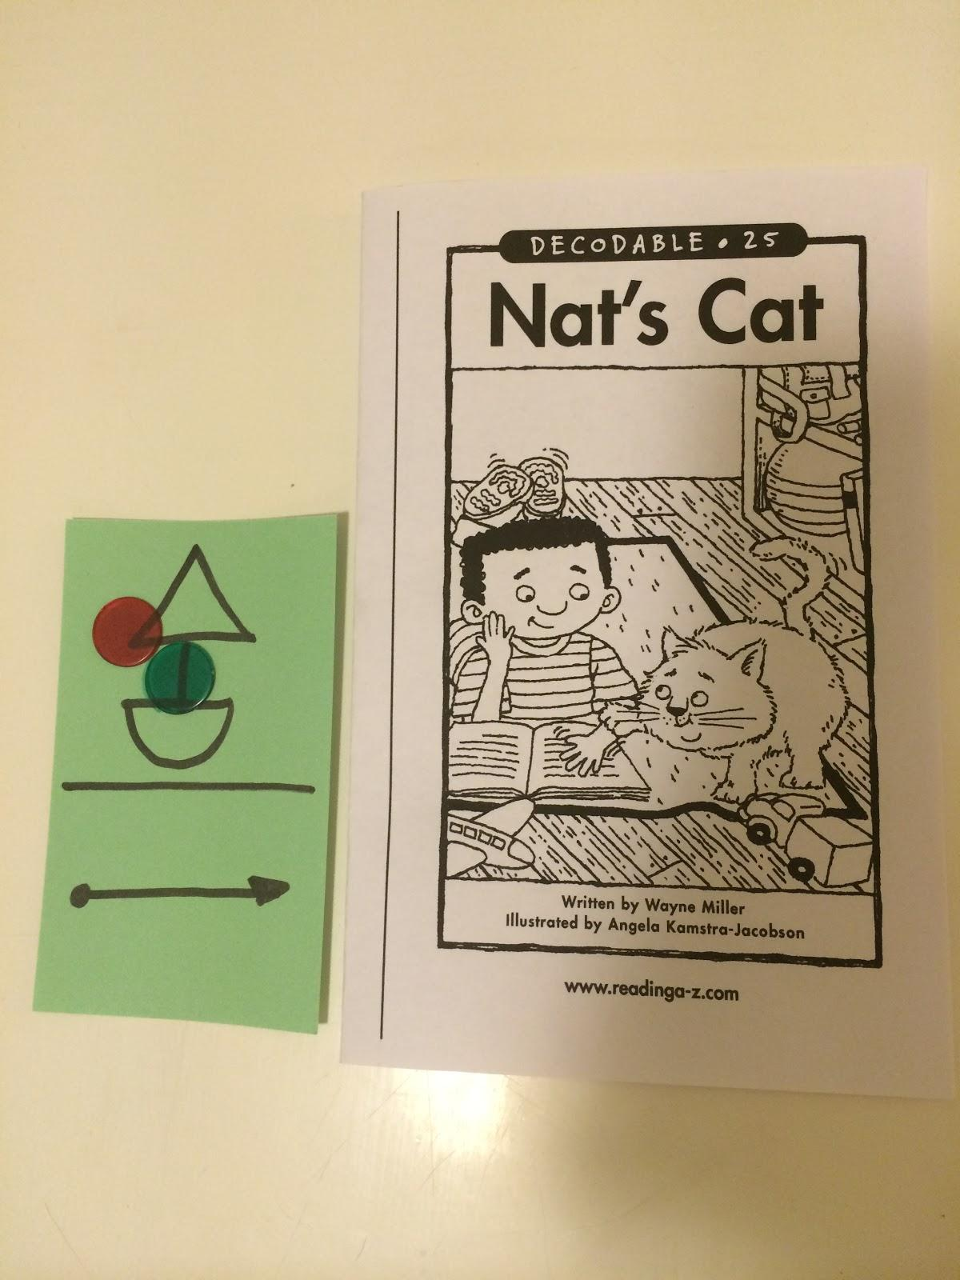
Next Steps, Generalizing RTC Skills, Extension
Teach the student to transfer the skill by introducing a simple decodable book with ‘Say it and Move it” strategy.
Fade support by introducing concept of “invisible chips”
introduce spelling patterns on chips ex: th, sh,er
Scaffold spelling with manipulatives or “How Many Sounds?”

Slide 19
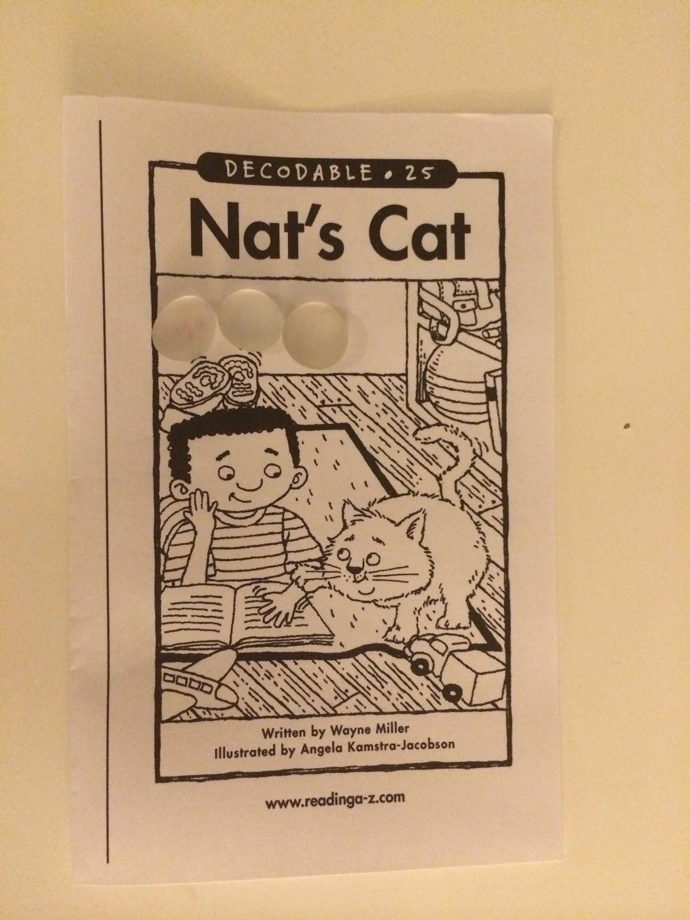
Next Steps, Generalizing RTC Skills, Extension
Highlight rules of syllabication using ‘Say it and Move it” strategy
Provide early, authentic writing activities
Build language, integrate GLAD strategies
Integrate Handwriting Without Tears (HWT)

Slide 20
Share out

Slide 21
Road to the Code: A Phonological Awareness Program for Young Children Spiral-bound – January 31, 2000
by Benita Blachman Ph.D. (Author), Eileen Ball Ph.D. (Author), Rochella Black M.S. (Author),

